Slide 1

Customer Shopping Behaviour Analysis
Python · SQL · Power BI
Analysing 3,900 transactions with 18 features to uncover actionable insights.

Slide 2

Project Overview: Decoding Customer Journeys
This project delves into customer shopping behaviour, meticulously analysing spending trends, product preferences, and customer segmentation to provide a holistic view of the customer landscape.
Methodology
Exploratory Data Analysis (Python)
SQL Business Queries
Power BI Dashboard Development
Objective
To generate robust, data-driven insights that empower strategic business decisions and foster growth.

Slide 3

Dataset Summary: A Glimpse into Customer Data
1
2
3
Data Volume
Key Features
Data Quality
3,900 transaction rows and 18 informative columns.
Age, Gender, Location, Subscription Status, Item Purchased, Category, Purchase Amount, Season, Size, Colour, Discount, Review Rating, Shipping Type, Previous Purchases, Frequency.
Identified 37 missing values in 'Review Rating', which were imputed using the category median to maintain data integrity.

Slide 4




Data Preparation: Laying the Foundation (Python)
Data Cleaning & Standardisation
Data Ingestion & Exploration
Addressed missing values and standardised column names to snake_case for improved readability and consistency.
Utilised pandas for efficient loading and initial exploration, including df.info() and df.describe() to understand data structure and summary statistics.
Database Integration
Feature Engineering
Removed the redundant promo_code_used column and seamlessly loaded the cleaned dataset into PostgreSQL for advanced SQL analysis.
Created new, impactful features such as age_group and purchase_frequency_days to enrich analytical capabilities.

Slide 5





Data Analysis using SQL: Key Business Insights
Revenue by Gender
Compared total revenue generated by male vs. female customers.
High-Spending Discount Users
Identified customers using discounts but spending above average.
Top 5 Products by Rating
Found products with the highest average review ratings.
Shipping Type Comparison
Analyzed average purchase amounts for Standard vs. Express shipping.

Slide 6
SQL Insights: Optimising Product Performance
Top 5 Products by Rating
Subscribers vs. Non-Subscribers
Gloves
3.86
Sandals
3.84
Yes
59.49
62645
Boots
3.82
No
59.87
170436
Hat
3.80
Non-subscribers contribute significantly more to total revenue, despite a slightly higher average spend from subscribers. This highlights an opportunity to convert more customers to subscriptions.
Handbag
3.78
Gloves, Sandals, and Boots emerged as the highest-rated products, indicating strong customer satisfaction in these categories.

Slide 7
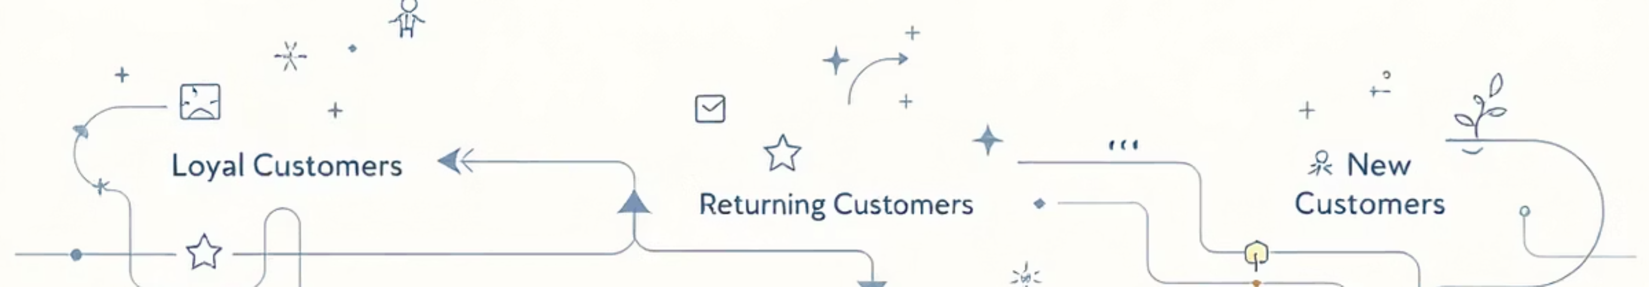



SQL Insights: Understanding Customer Segmentation
Loyal Customers
Returning Customers
New Customers
3,116 customers, representing a significant segment with consistent purchase history.
701 customers who have made repeat purchases but are yet to achieve loyal status.
83 customers, a crucial segment for growth and conversion strategies.
Repeat buyers show a notable correlation with higher subscription likelihood, emphasising the importance of fostering customer loyalty.

Slide 8





Business Recommendations: Actionable Strategies for Growth
Boost Subscription Adoption
Refine Discount Strategy
Implement exclusive benefits and targeted campaigns to convert more customers into subscribers.
Rethink discount offers to strike an optimal balance between driving sales and maintaining healthy profit margins.
Introduce Loyalty
Programs
Design structured loyalty initiatives to nurture returning customers
into loyal advocates.
Promote High-Performing
Products
Target High-Value Segments
Prioritise top-rated and best-selling products in marketing campaigns to maximise impact.
Focus marketing efforts on high revenue age groups and customers who prefer express shipping for increased ROI.

Slide 9

Conclusion: A Holistic Approach to Data Analytics
End-to-End Analytics
Clear & Actionable Insights
Demonstrates robust full-stack analytics capabilities, from Python-driven EDA and SQL-based insights to interactive Power BI dashboards.
Uncovered distinct patterns in customer spending and behaviour, providing a solid foundation for strategic decision-making.
Strategic Recommendations
Delivered actionable recommendations geared towards boosting revenue, enhancing customer loyalty, and optimising business operations.

